Slide 1

COVIRAD
(COVID DETECTION USING RADIOLOGY)
Edara Sai Srija : 1275300 Mohammed Safwan Aslam Kazi : 1270795 Mehreet Singh Bajaj : 1274698 Maitry Jariwala : 1275288
Identify and localize COVID-19 abnormalities on chest radiographs

Slide 2
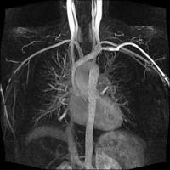
COVID-19 → morbidity and mortality.
Like other pneumonias, pulmonary infection with COVID-19 results → inflammation and fluid in the lungs.
Similar to other viral and bacterial pneumonias on chest radiographs → makes it difficult to diagnose.
diag by PCR → slow process (takes days)

Slide 3
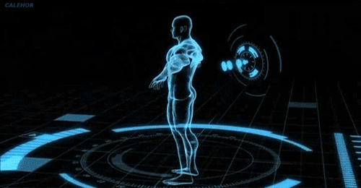
LET'S GET STARTED

Slide 4

IDEOLOGY
COVID-19 → PCR but slow (how?)
move to → CHEST CT / MRI SCAN
chest radiographs → in min
COVID 19 different from other chest infections → differentiating methods varies
Patients life → saved before time (based on level of infection)
Notes:
No one has time to read paragraphs make it short points

Slide 5
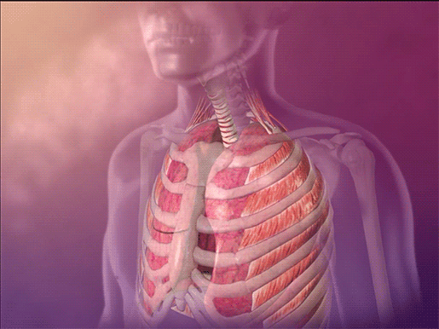
TARGET
Identify and localize COVID-19 abnormalities on chest radiographs.
Categorize the radiographs as
negative for pneumonia
typical
indeterminate
atypical
for COVID-19.
Radiologists diag →mill COVID patients and resulting in saving more lives

Slide 6
SIIM-FISABIO-RSNA
SIIM → Society for Imaging Informatics in Medicine
FISABIO → Foundation for the Promotion of Health and Biomedical Research of Valencia Region
RSNA → Radiological Society of North America
SIIM in partnership with FISABIO and RSNA provided the official data during their 6th annual Conference on Machine Intelligence in Medical Imaging.
SIIM-FISABIO-RSNA
goal → develop high quality computer vision models → detect and localize COVID 19 diseases → help doctors for confident diagnosis
Notes:
SIIM-FISABIO-RSNA → required engineers → to develop high quality computer vision models → which detects and localize COVID 19 diseases to help doctors provide quick and confident diagnosis

Slide 7
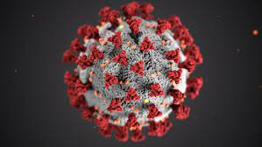
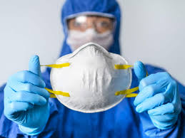
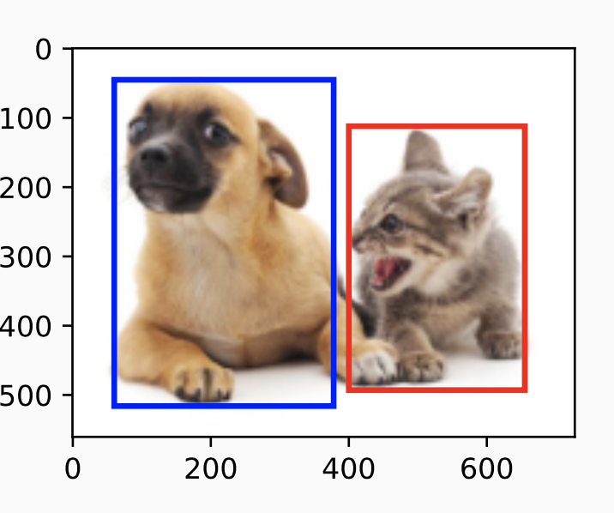
Covid-19 symptoms → similar to other viral or bacterial pneumonias/ chest radiographs, hence it's much harder to correctly diagnose.
Image Classification
object detection and classification problem
detect and localize objects of interest throughout its navigation of an environment.
predict a bounding box and a class.

Slide 8
LABELLING
-VE PNEUMONIA
TYPICAL
ATYPICAL
INTERMEDIATE
Notes:
-VE FOR PN : No particular lung infection for pnum (factors) directing us to COVID infection traces
- TYPICAL : Typical factors (usually lung infection ) leading to traces of covid infection
Atypical - Atypical traces of covid (not directly lung infection )- Can show infection in other parts of body
-Intermediate : Showing intermediate traces of infection leading to COVID infection

Slide 9
APPROACH
Determine a label for each from the following
Negative for Pneumonia' 'Typical Appearance' 'Indeterminate Appearance' 'Atypical Appearance'
Predicting a Bounding Box and Class for all
Prediction string similar to class “none” class
atypical 1 0 0 1 1
Notes:
IF NO BOUNDING BOX FORMED WILL BE MARKED AS NONE

Slide 10
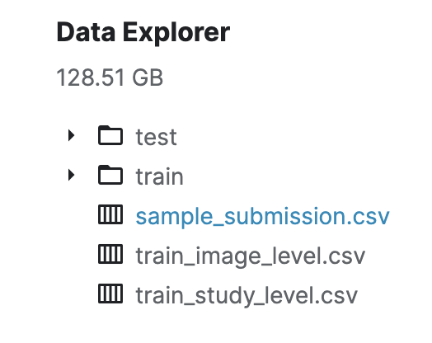
DATASETS
6,334 Chest Scans
DICOM format
contains our labels
Notes:
Dicom (Digital Imaging in Medicine) medical image datasets, storage and transfer.

Slide 11
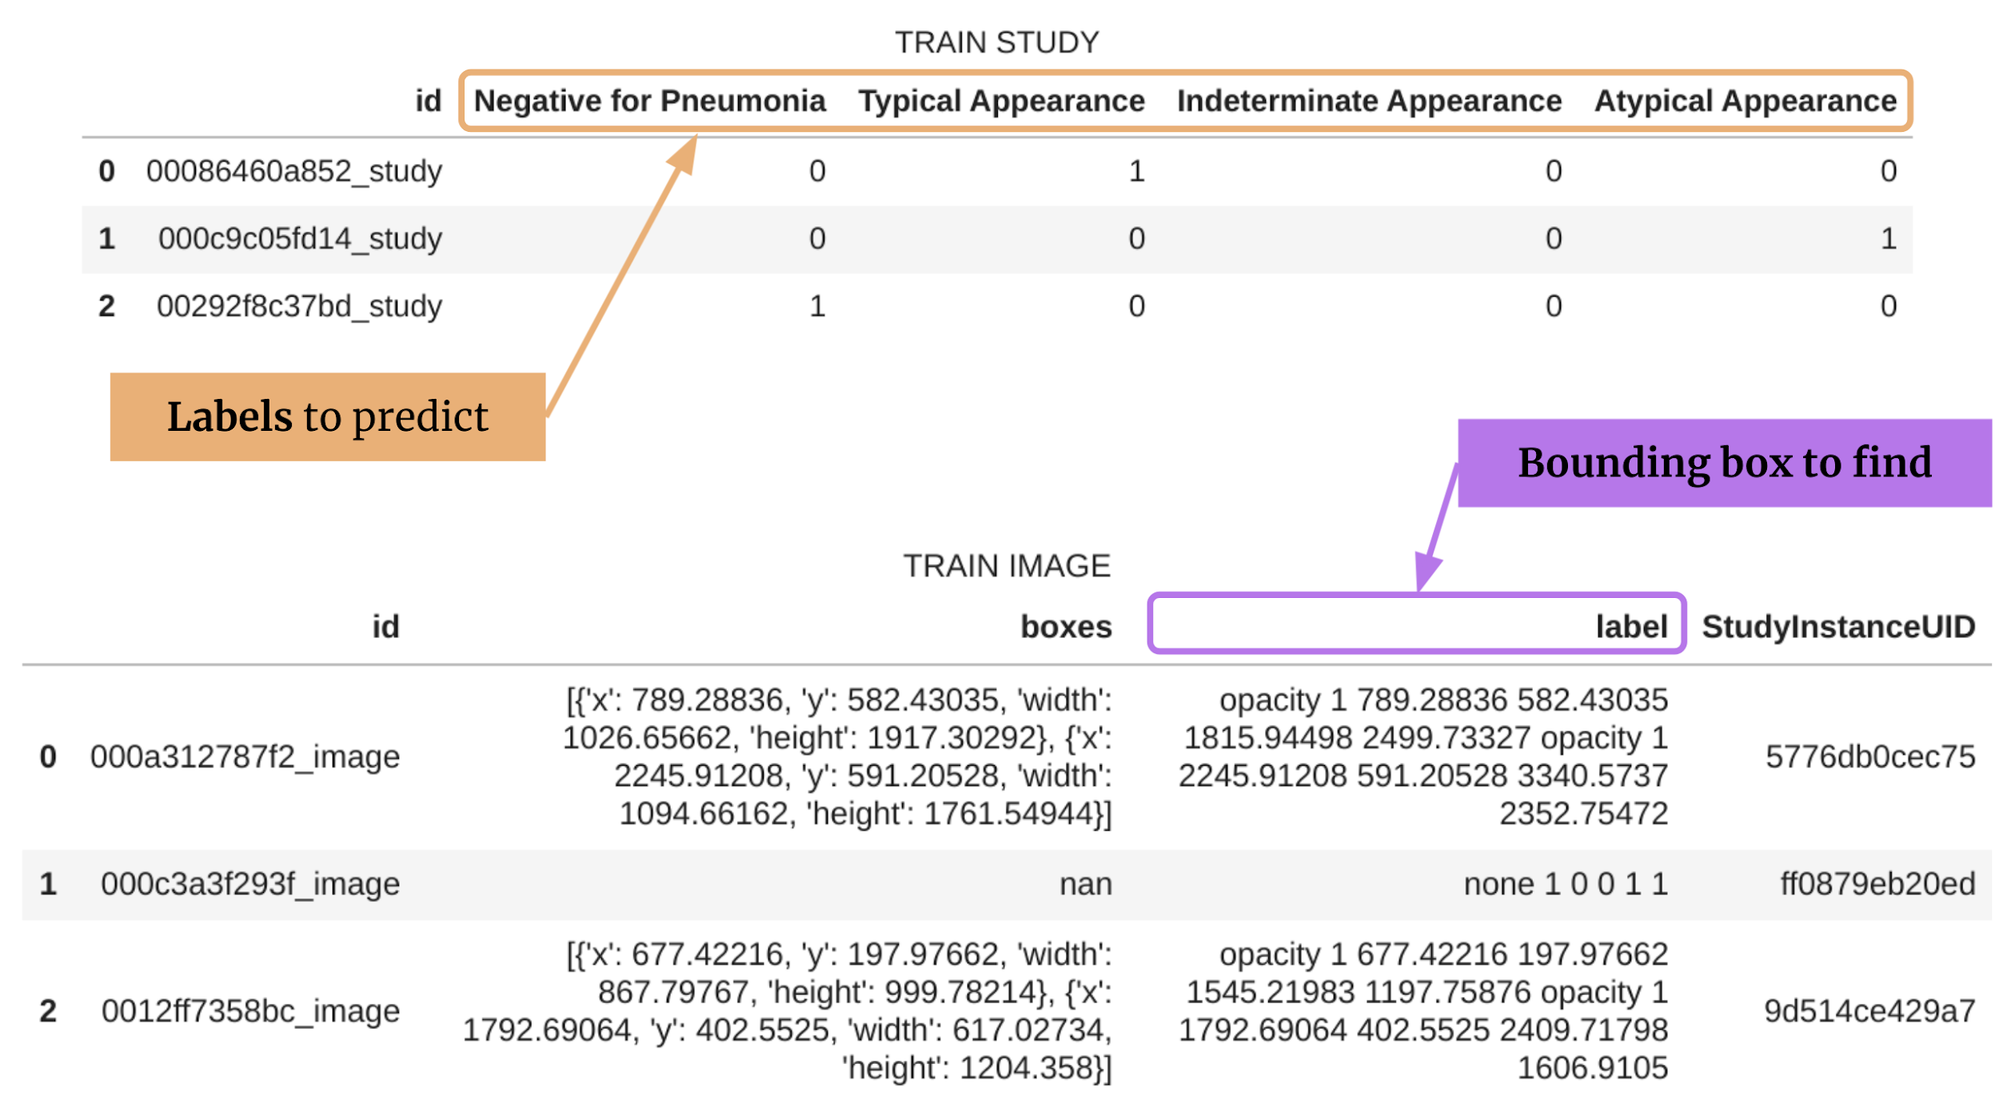
METADATA
Notes:
FILES SAVED AS CSV
LABELS AND BOXES DICOM FORMAT
USUALLY IMAGES ARE IN JASON FILE FORMAT BCUZ IMAGES ARE IN PIXEL FORM IN X AND Y AXES

Slide 12
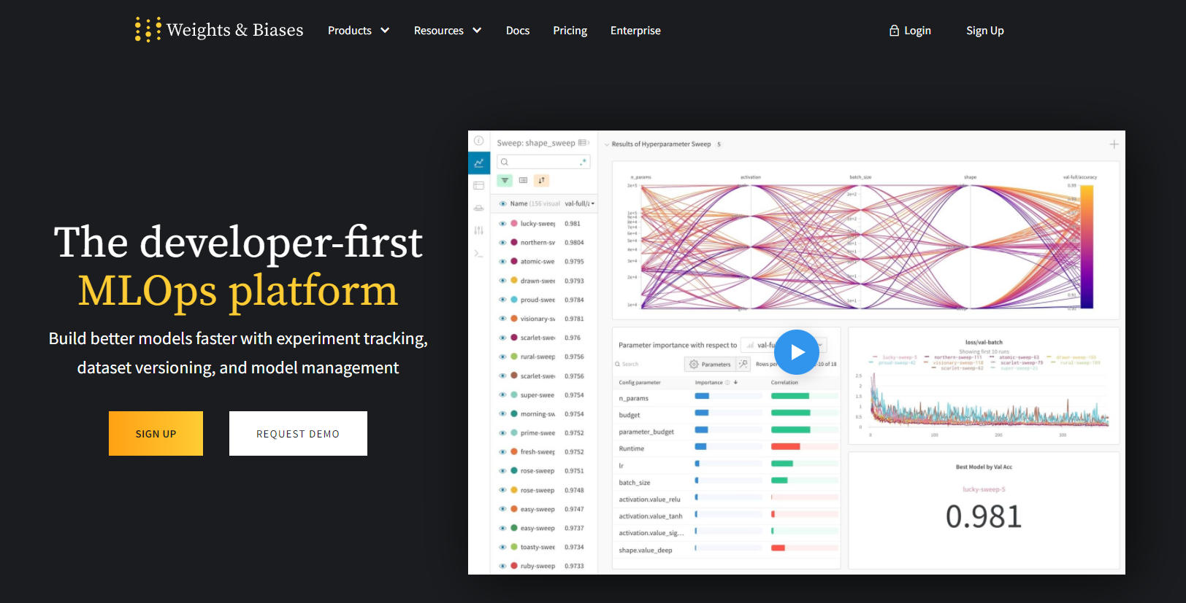
WANDB
WandB → Weights & Biases
real time monitoring tool for tracking implemented ml algorithms in real-time environment
a central dashboard to keep track of your hyperparameters, system metrics, and predictions
Resulting → compare models live and share your findings
Notes:
Weights & Biases (WandB) is a python package that allows us to monitor our training in real-time. It can be easily integrated with popular deep learning frameworks like Pytorch, Tensorflow, or Keras. Additionally, it allows us to organize our Runs into Projects where we can easily compare them and identify the best performing model. In this guide, we will learn how to use WandB for logging.

Slide 13
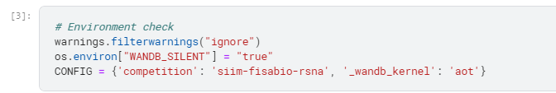
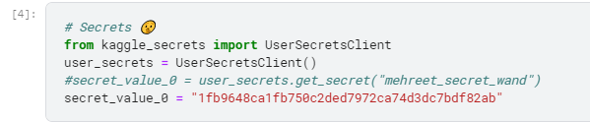
STUDY ANALYSIS
The train data is analysed with no duplicates found and there are 6054 unique ids.
Target: one of our targets is to predict is the radiography is “negative_for_pneumonia” , has “typical” appearance, has “indeterminate” appearance.
An image can have positive value for only 1 label. It's only one or the other.
class imbalance is present - especially for Indeterminate Appearance and Atypical Appearance.

Slide 14
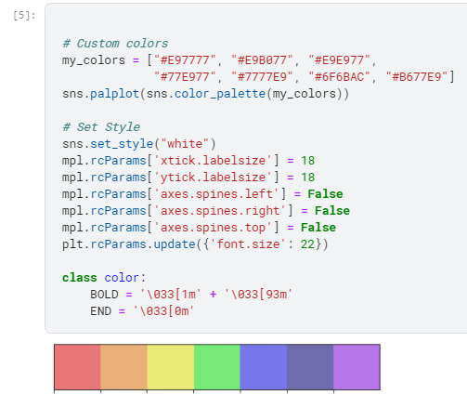
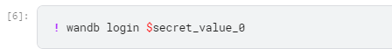
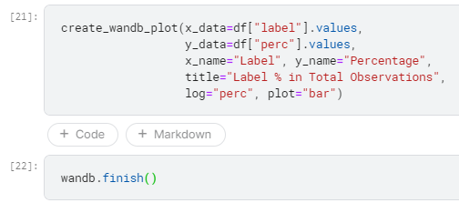
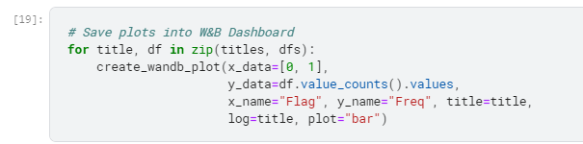
STUDY ANALYSIS

Slide 15
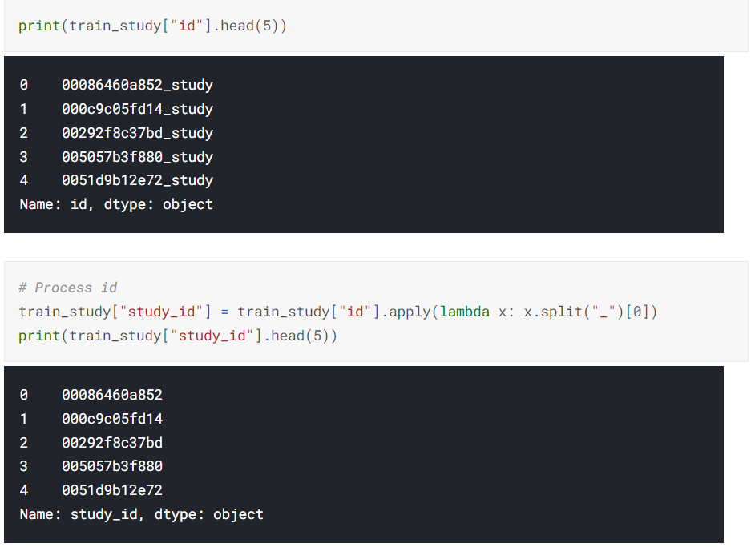
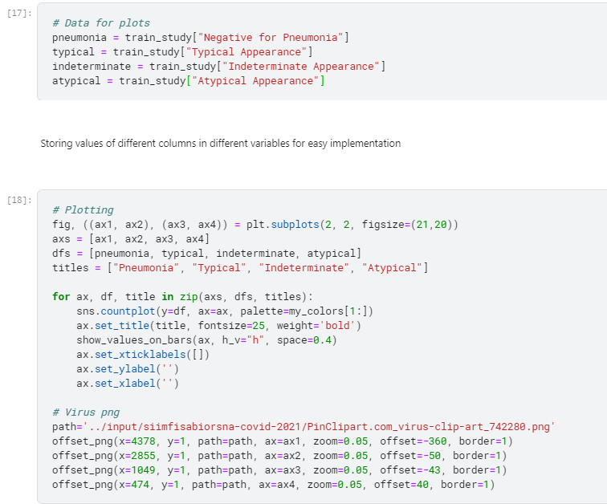
STUDY ANALYSIS

Slide 16
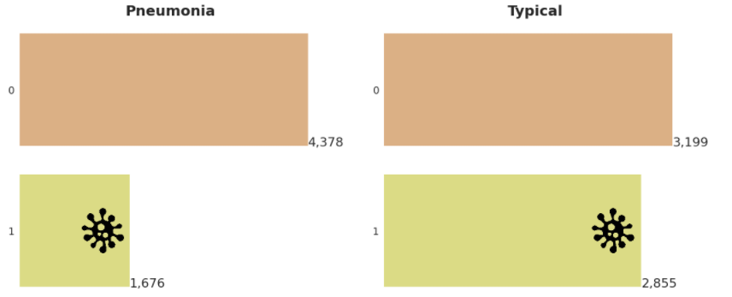
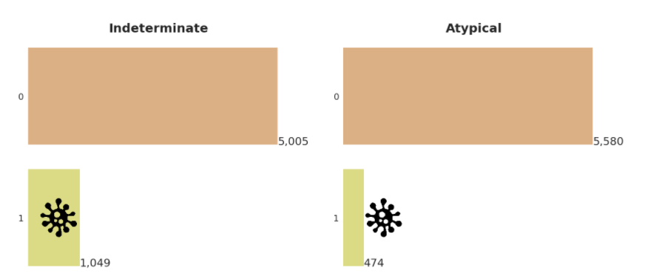
STUDY ANALYSIS

Slide 17
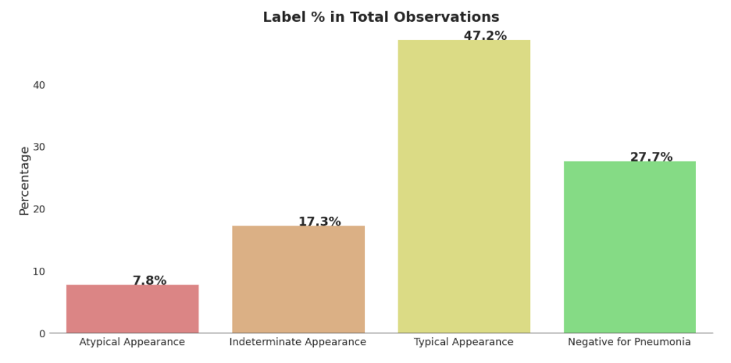
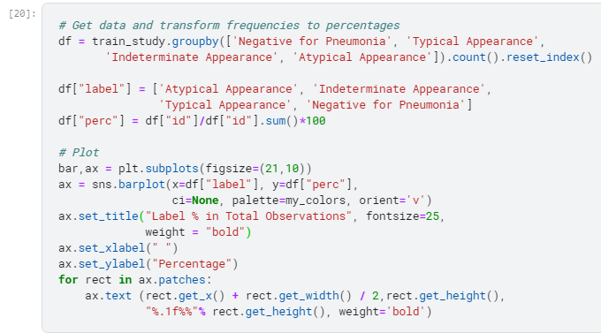
STUDY ANALYSIS

Slide 18
STUDY ANALYSIS
WEIGHT & BIAS
Weights & Biases (W&B) is a set of machine learning tools that helps you build better models faster.
Dashboards- log and visualize experiments in real time ,keep data in one convenient place.
Artifacts-store and version datasets, models, results.

Slide 19
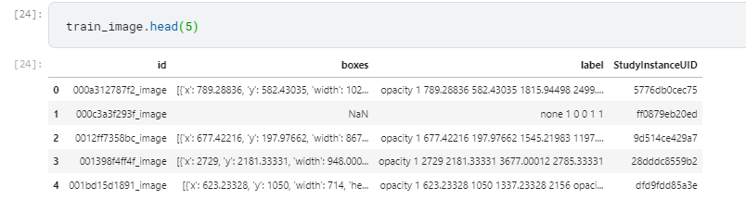
IMAGE ANALYSIS
StudyInstanceUID corresponds 1:1 to new_id.
image_id is unique in the image_train data.
There are images with multiple bounding boxes.

Slide 20
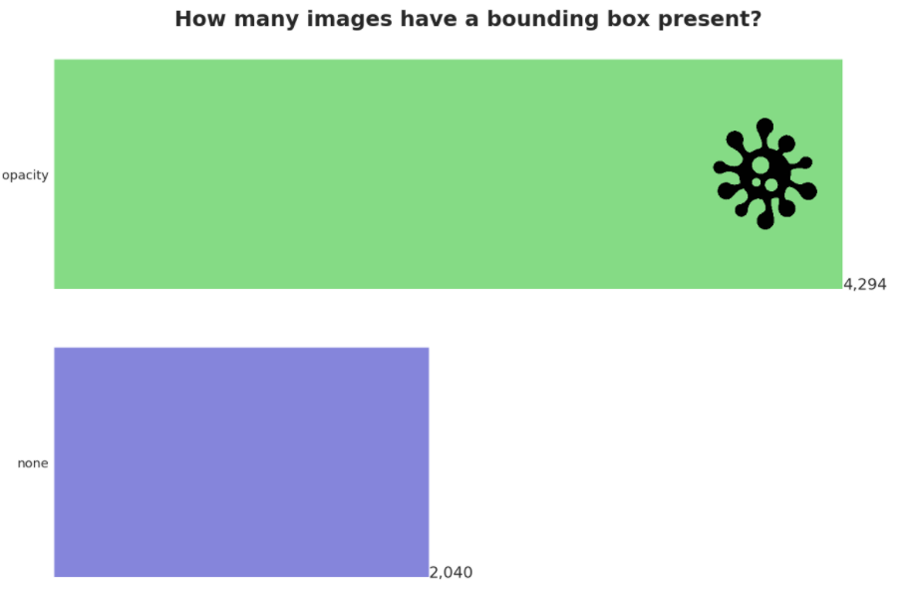
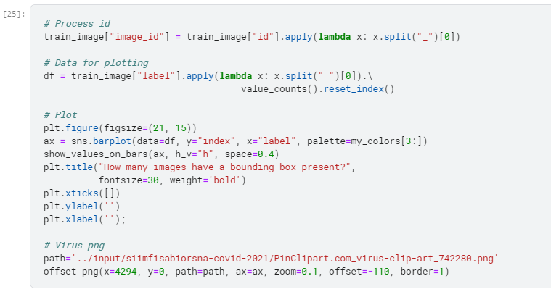
IMAGE ANALYSIS

Slide 21
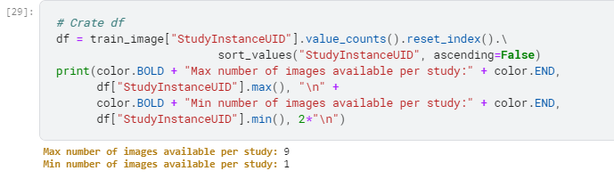
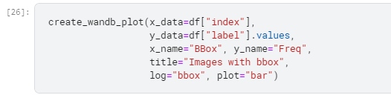
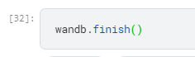
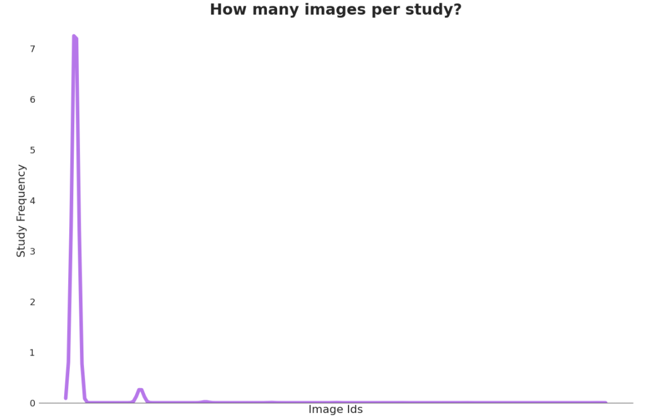
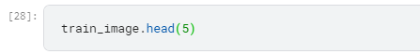
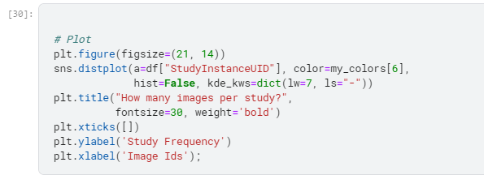
IMAGE ANALYSIS

Slide 22
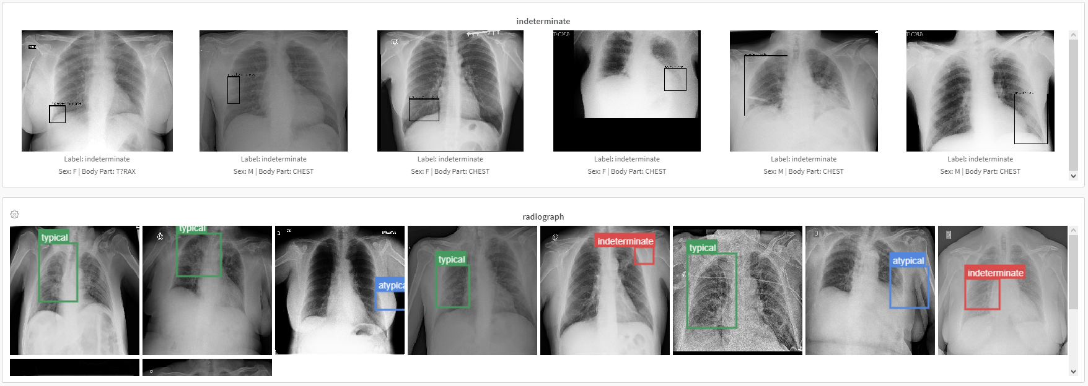
IMAGE ANALYSIS

Slide 23
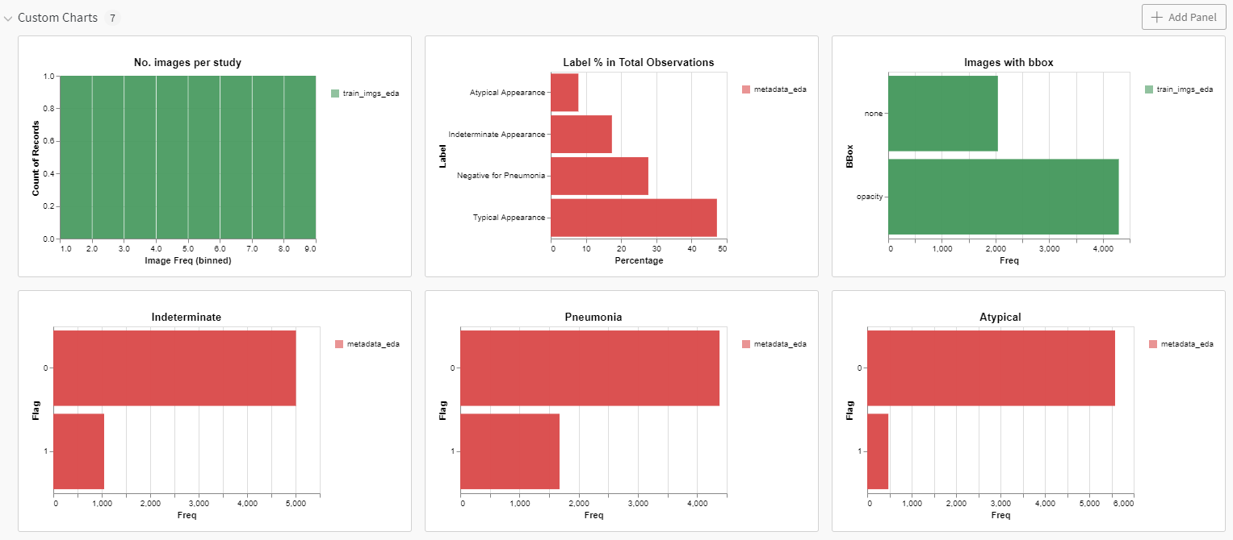
IMAGE ANALYSIS

Slide 24
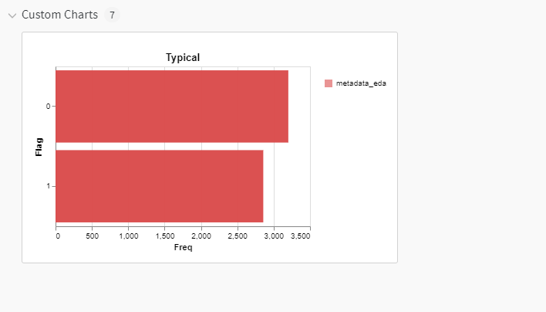
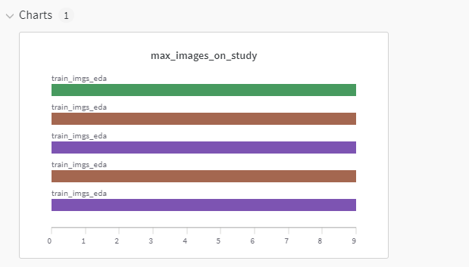
IMAGE ANALYSIS

Slide 25
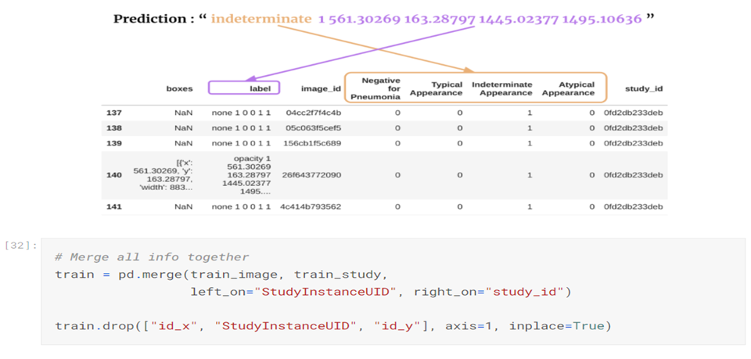
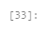
IMAGE ANALYSIS
Notes:
Data frame objects

Slide 26
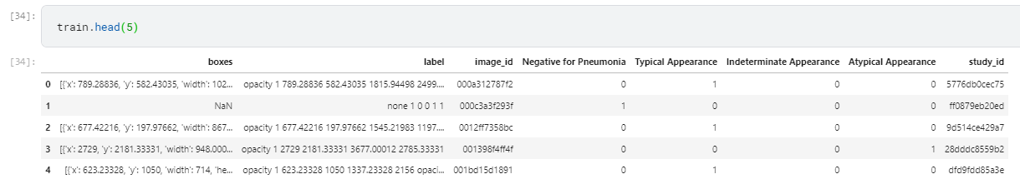
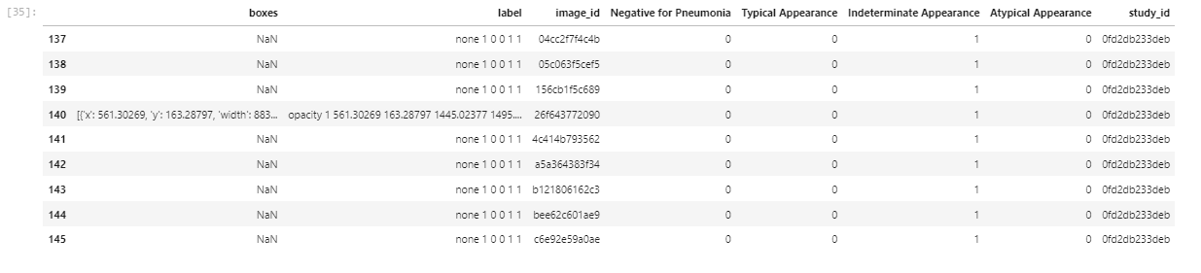
IMAGE ANALYSIS

Slide 27
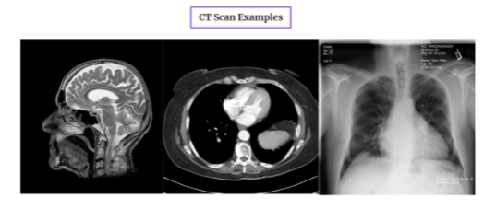
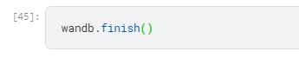
IMAGE ANALYSIS
CT Scans?
Computerized Tomography scan → uses computers and rotating X-ray machines to create cross-sectional images of the body.
These images provide more detailed information than normal X-ray images.
They can show soft tissues, blood vessels, and bones in various parts of the body.

Slide 28
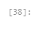
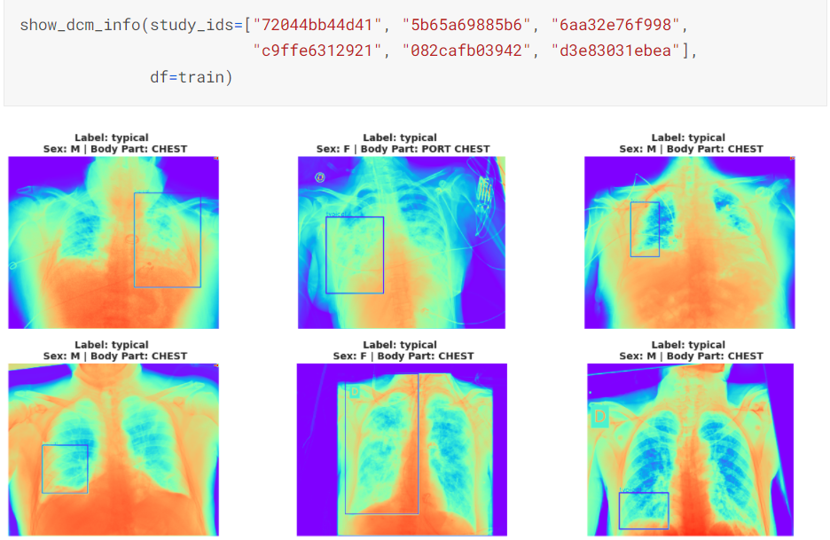
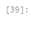
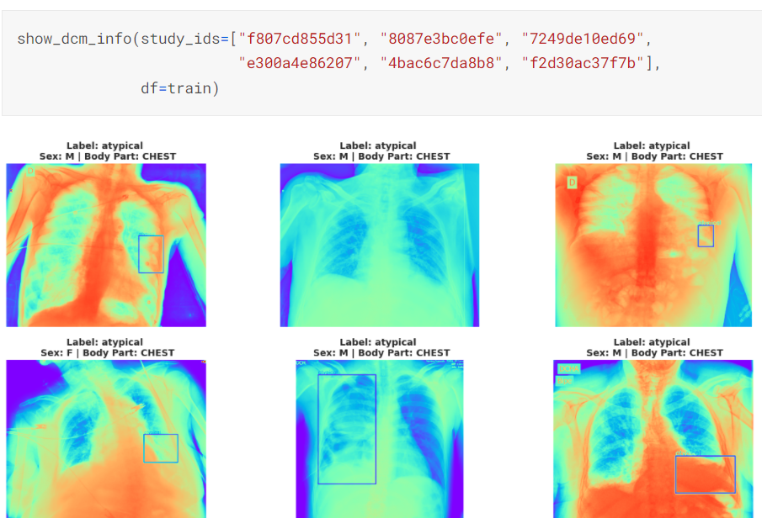
IMAGE ANALYSIS
Typical Appearance
Atypical Appearance

Slide 29
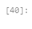
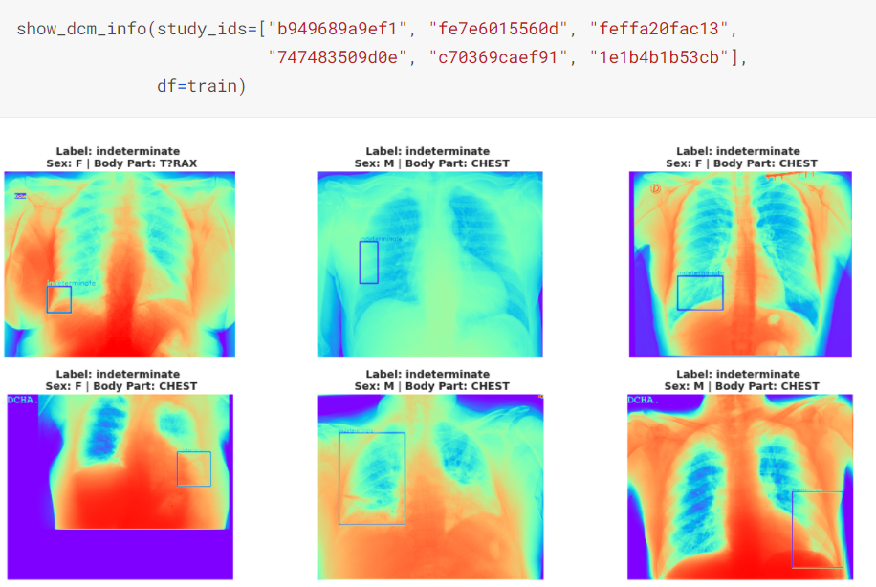
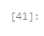
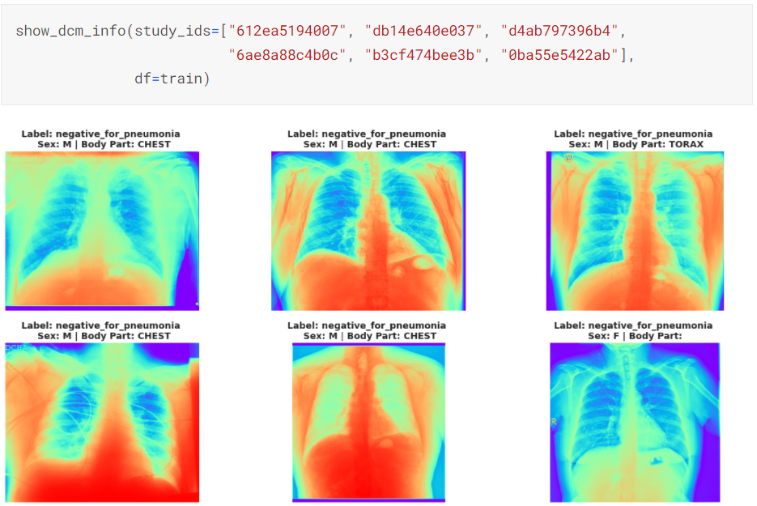
IMAGE ANALYSIS
Indeterminate Appearance
Negative for Pneumonia

Slide 30
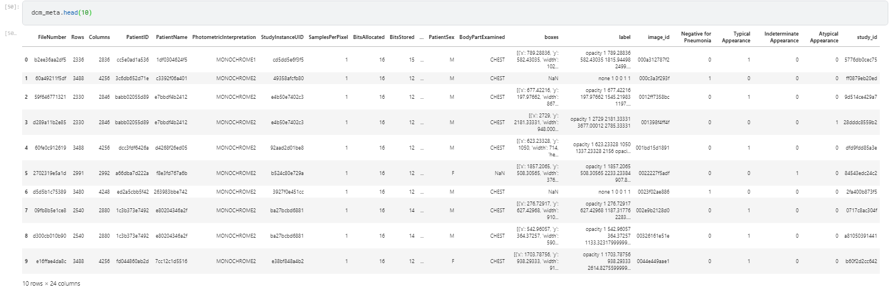
MORE ANALYSIS
Final Merged Data Frame Object

Slide 31
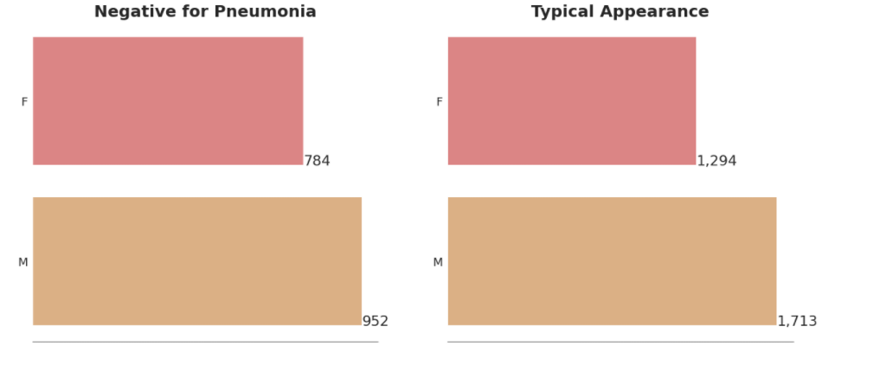

GENDER ANALYSIS

Slide 32

MORE ANALYSIS

Slide 33

MORE ANALYSIS

Slide 34

MORE ANALYSIS

Slide 35

MORE ANALYSIS

Slide 36
Exploratory Dashboard in W&B
https://i.imgur.com/P8tdXpU.mp4
https://wandb.ai/mehreet/siim-covid19?workspace=user-mehreet

Slide 37
REFERENCES
BIMCV COVID-19+: a large annotated dataset of RX and CT images from COVID-19 patients
The RSNA International COVID-19 Open Radiology Database (RICORD)
https://doi.org/10.31219/osf.io/532ek
https://docs.wandb.ai/
https://siim.org/news/580751/SIIM-FISABIO--RSNA-Recognize-Winners-of-the-COVID-19-Detection--Localization-Challenge-on-Kaggle.htm

Slide 38
THANK YOU!

